Slide 1
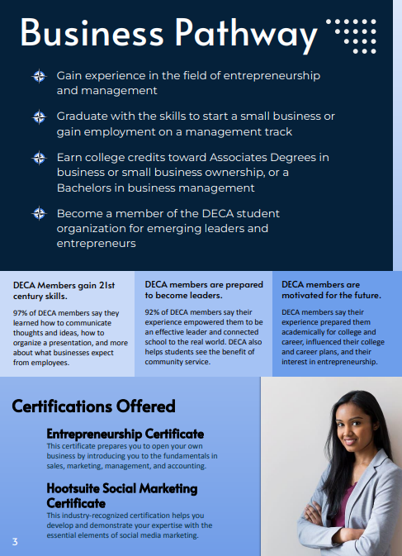
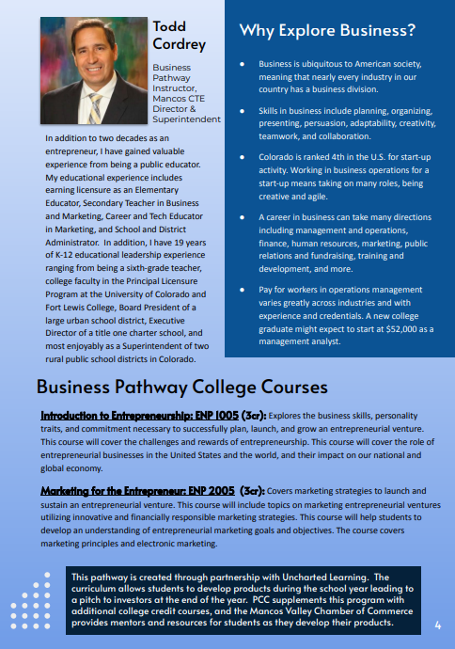
The non-profit Uncharted Learning curriculum at 120 HS
PCC 1005 Entrepreneurship
PCC 2005 Entrepreneurship
DECA student organization
Two career certifications
Community advisory group

